Slide 1


Disrupting Medicine using
Electronic Medical Records
Uri Kartoun PhD
Center for Computational Health
IBM Cambridge Research Center
March 2019

Slide 2
Schedule
Guest lectures
Florence, an IBM Master Inventor and a senior architect, will share her extensive experience in inventing.
FX will share of his extensive experience as a physician, working also for start-ups and with IBM Research and Watson Health.
Yoonyoung, a Harvard graduate, will give an introductory overview of a variety of statistical approaches.
Use the “Right Heart Catheterization Dataset” made available by Vanderbilt university
Team 1: Is “right heart catheterization” beneficial to patients? Is it beneficial to certain patients but harmful to others?
Team 2: Is “right heart catheterization” beneficial to patients? Explore “confounding” (one of the most common biases in observational databases).
Introduction to R using EMRBots
Introduction to electronic medical records
What are EMRs and what is valuable about them? Go through several use cases.
March 5
March 7
March 12
Next lectures
Disrupting medicine using electronic medical records

Slide 3
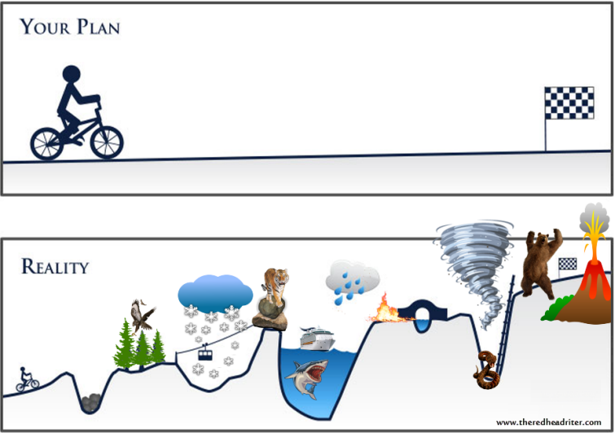
A glimpse of my life…
HMS students visit IBM
Born

Slide 4
A glimpse of my career…
Health Solutions Group at Microsoft
IBM Research
Granted
a PhD
Microsoft
Research
Harvard Medical School /
Mass General Hospital
2008
2016
Robotics
Healthcare Informatics
Machine learning & Statistics

Slide 5
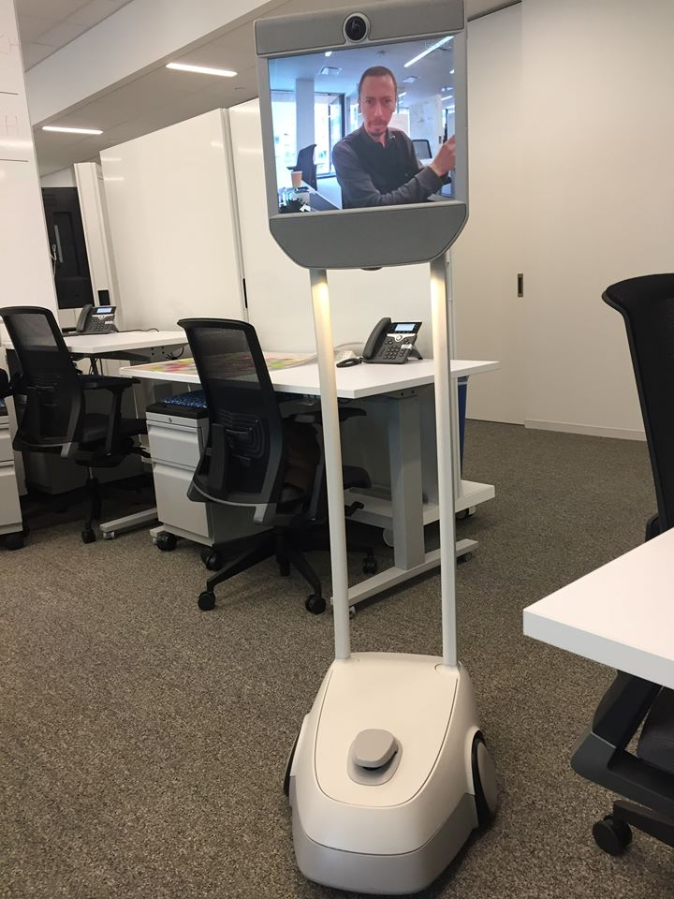
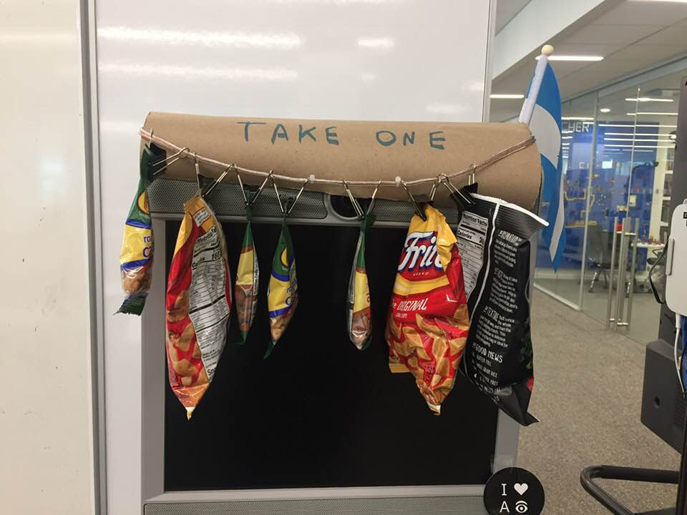
We also have robots…
Personal Snack Assistant

Slide 6

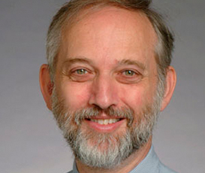




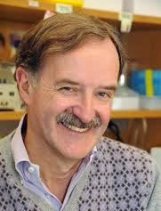
Colleagues during my fellowship at Mass General Hospital
Peter Szolovits
(MIT)
Stanley Shaw
(MGH)
Tianxi Cai
(Harvard)
Me
(Couple of years ago)
Kathleen Corey
(MGH)
Zak Kohane
(Harvard)
Garret FitzGerald
(UPenn)

Slide 7
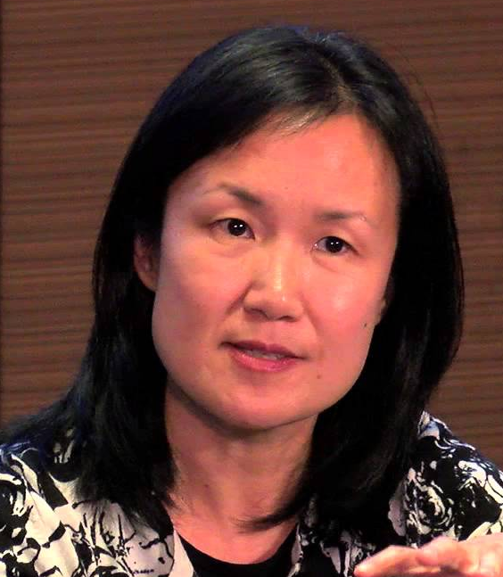




More recent colleagues
Kenney Ng
(IBM Research)
Jianying Hu
(IBM Research)
Me
(Current)
Kathleen Corey
(MGH)
Paul Tang
(IBM Watson)
+ Many others from
IBM Research &
Watson Health
Chin Hur
(Columbia University)

Slide 8


A glimpse of prediction modeling
Nov. 12, 1955: lightning struck the clock tower providing 1.21 gigawatts power to send Marty McFly and the DeLorean back to 1985.

Slide 9
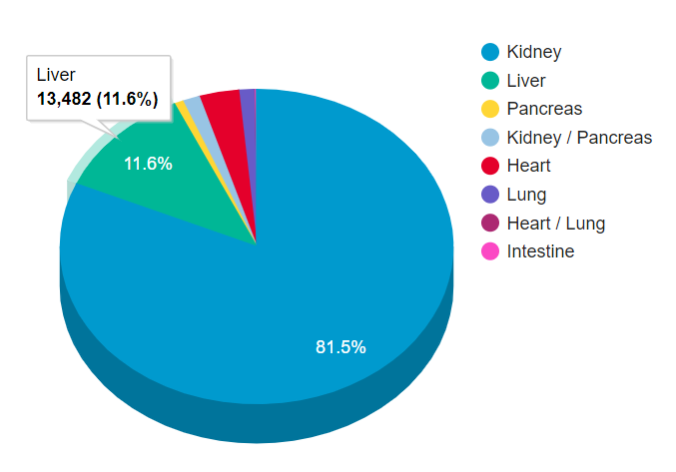
An example for how data can advance medicine: The MELD score
[Feb 16, 2019]
Notes:
https://unos.org/data/transplant-trends/waiting-list-candidates-by-organ-type/

Slide 10

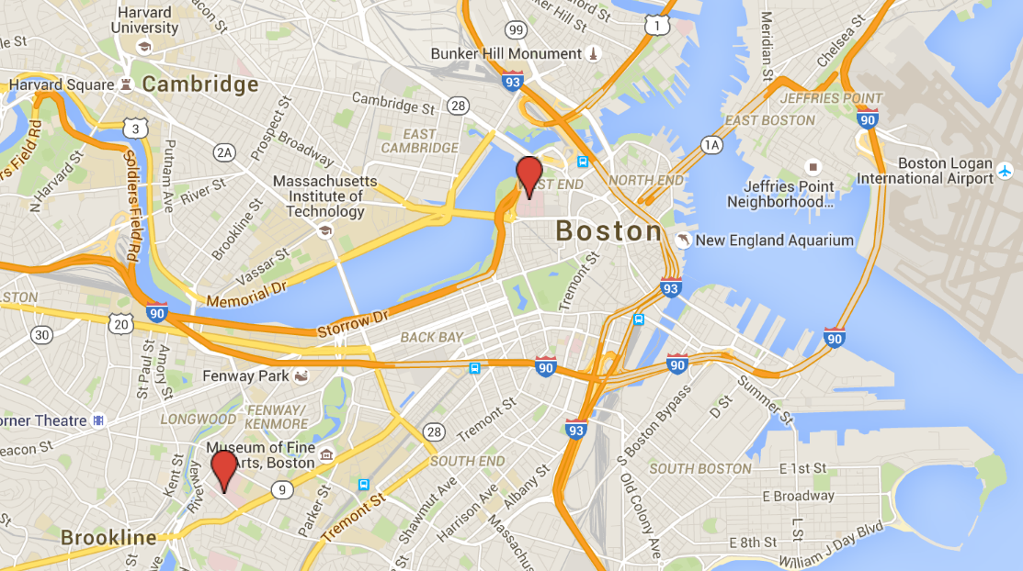
What are actually electronic medical records (EMRs)?
Massachusetts General Hospital
AND
Brigham and Women’s Hospital
~4M patients
≥1 ICD9 for diabetes
OR
≥1 diabetic medication
OR
HGB A1C ≥ 6.5%
OR
Plasma Glucose ≥ 200 mg/dl
314,292 patients
(~1TB)
Notes:
ICD = International Classification of Diseases

Slide 11
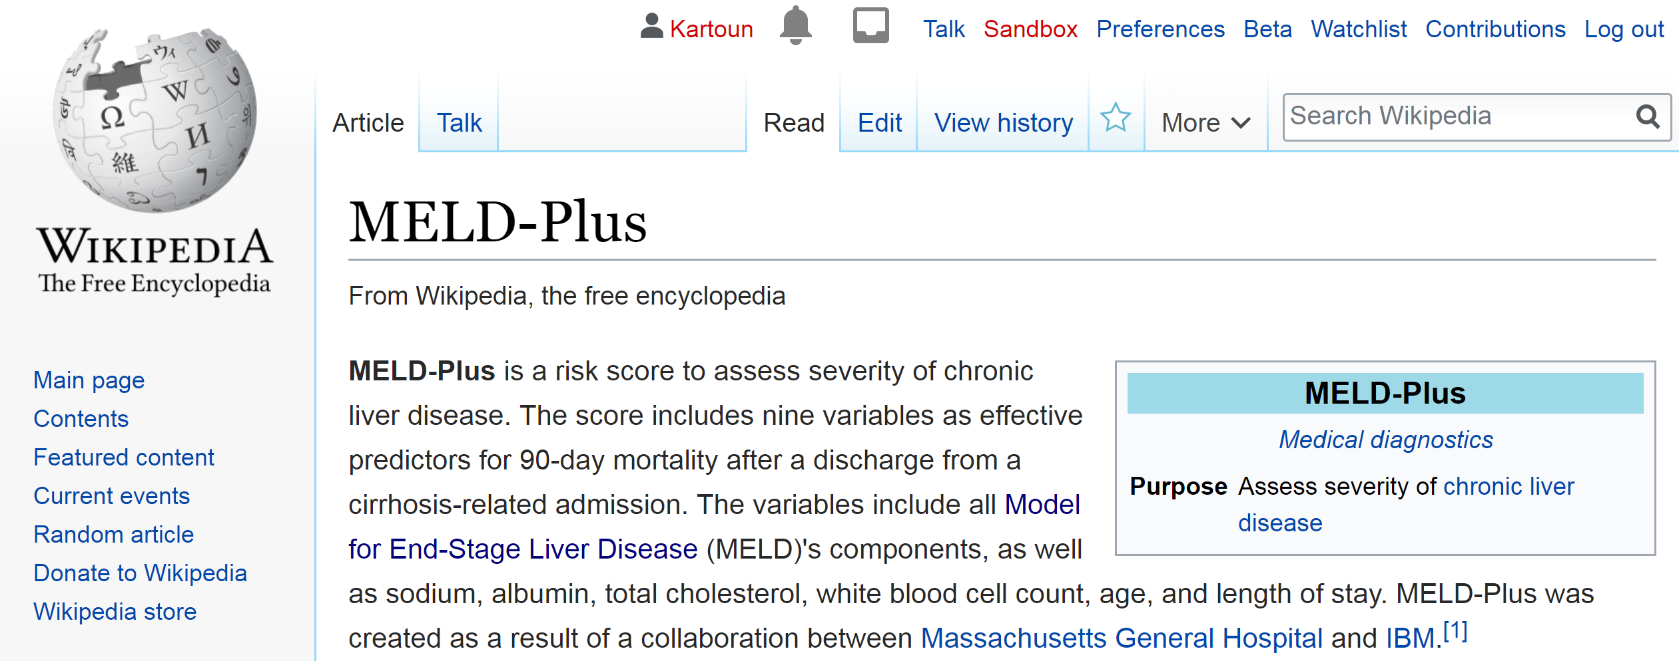
An example for using EMRs: The MELD-Plus score
A collaboration between Massachusetts General Hospital and IBM Research.

Slide 12
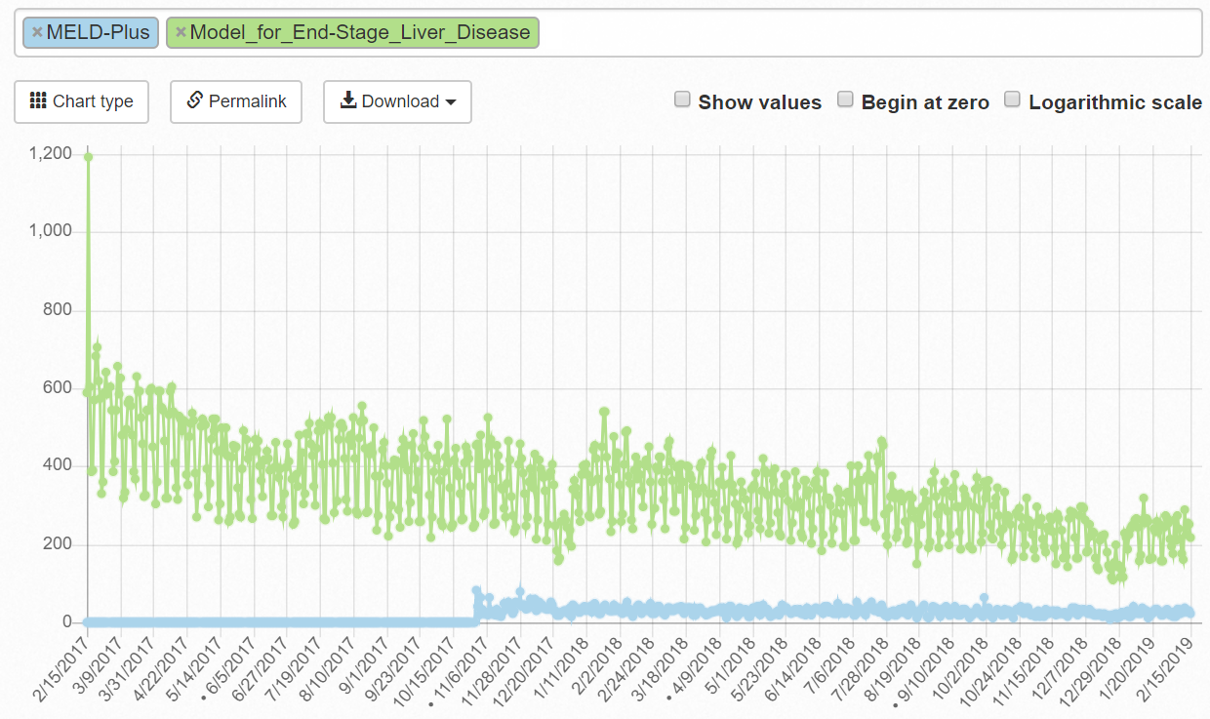
The MELD-Plus statistics on Wikipedia

Slide 13
Health care before and during the era of data…
Pancreas functionality and diabetes are connected.
Increased HbA1c and diabetes are linked.
Adler
1912
MELD
2002
Minkowski
1889
Rahbar
1969
90s…
MELD-Plus
2017
Tobacco smoking increases risk to develop lung cancer.
Limited computational
resources
Broad use of
EMRs
No computers
A continuous effort to improve health care
Notes:
Among the most important clinical links ever discovered throughout history are…

Slide 14
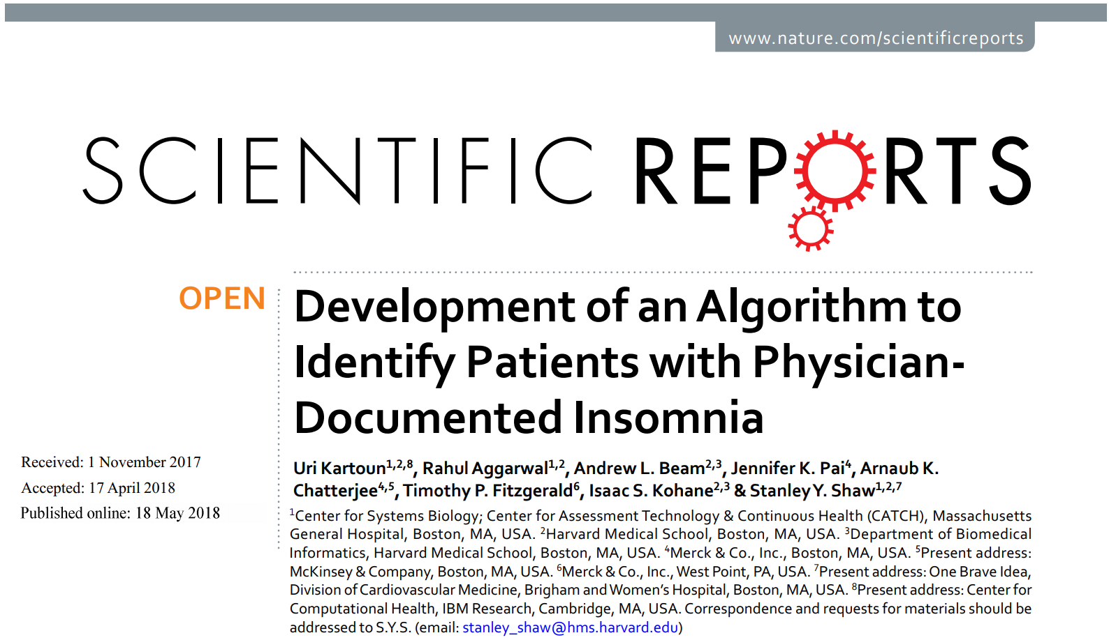
Could data help identifying patients with insomnia?
Notes:
https://www.nature.com/articles/s41598-018-25312-z

Slide 15
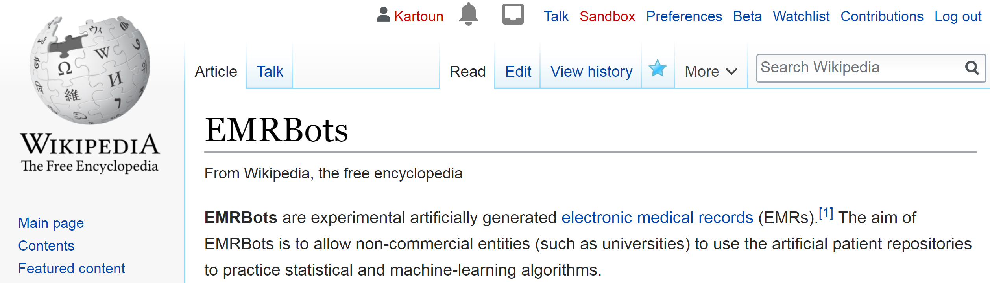
What are EMRBots?
Motivation: only a small number of individuals are given permission to access EMRs.

Slide 16
Are there good tutorials that actually demonstrate how to use EMRBots?
Yes!
Mayampurath A, Johnson J.
Statistical modeling of clinical data.
Center for Research Informatics at the University of Chicago.
http://cri.uchicago.edu/wp-content/uploads/2018/02/CRI_StatisticalModeling_Methods.pdf

Slide 17
Beyond this workshop
MELD
2002
HMS at IBM
2019
2073
90s…
MELD-Plus
2017
What can we do further
to disrupt health using data?
EMR analysis
Prediction modeling
Disease classification
Human-computer interaction
Decision support
Visualization

Slide 18
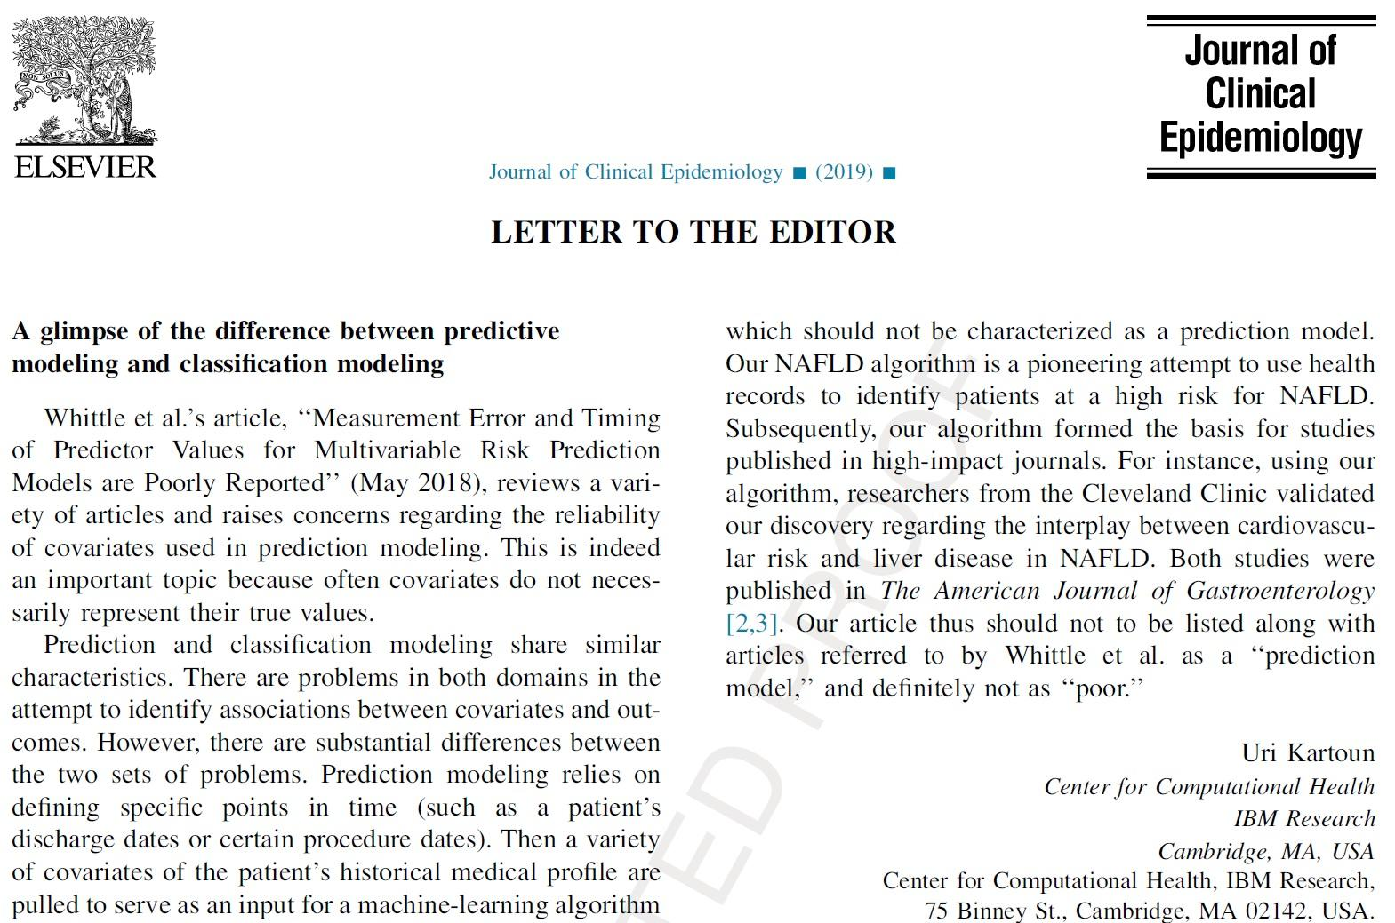
Prediction != Classification

Slide 19
A use case:
A Prediction Model to Assess Mortality Risk in Cirrhosis

Slide 20
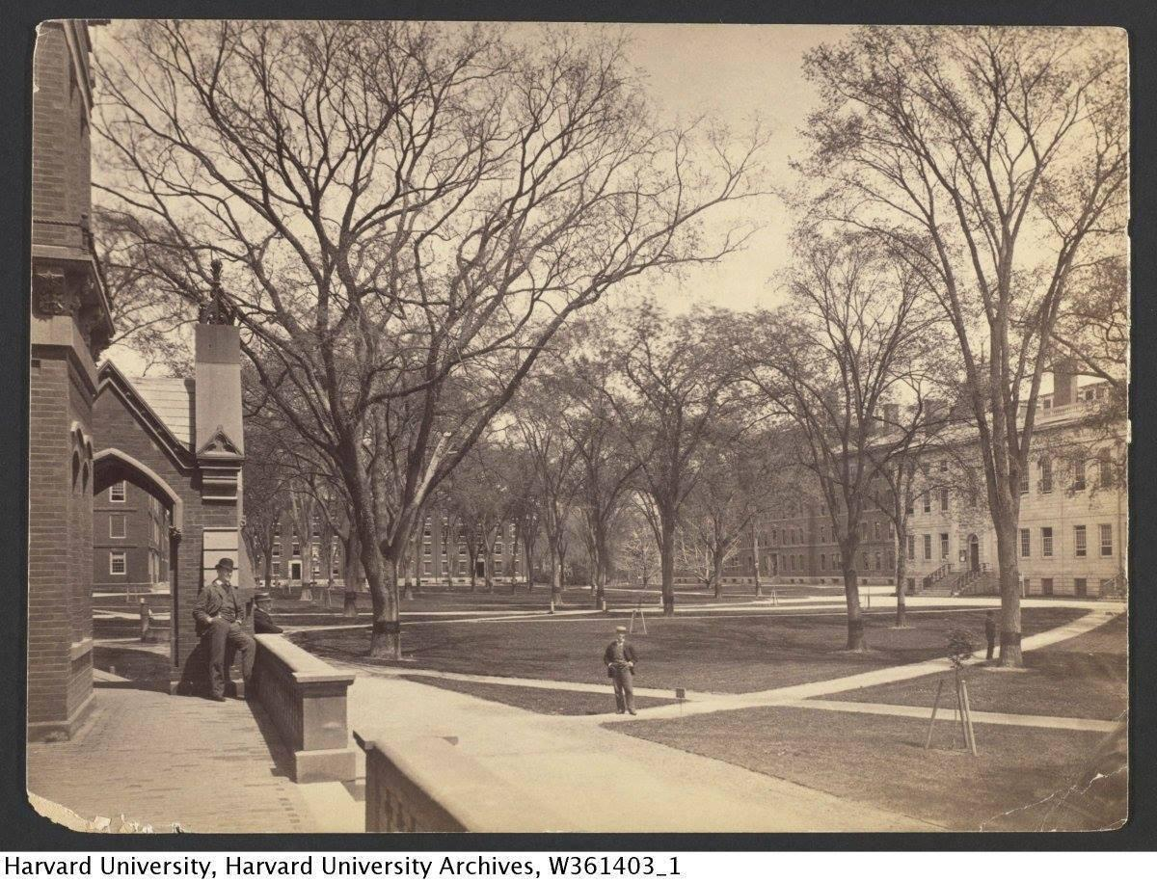

Slide 21
What is known?
Cirrhosis
Cirrhosis-related complications account for 1.1% and 1.8% of all deaths in the United States and Europe, respectively.^{1,2}
Individuals with cirrhosis suffer from significantly worse health status and greater disability compared to those without cirrhosis.³
Identifying patients at high risk for mortality
The MELD score has been widely adopted to predict patient outcomes in cirrhosis.^{4,5}
The MELD-Na score (an extended version of MELD incorporating sodium), has been recently adopted for liver transplant allocation.⁶
1. Kim et al. 2002.
2. Blachier et al. 2013.
3. Rakoski et al. 2012.
4. Malinchoc et al. 2000.
5. Kamath M et al. 2001.
6. Mulligan and Hirose (Organ Procurement and Transplantation Network (OPTN) / United Network
for Organ Sharing (UNOS), Liver and Intestinal Organ Transplantation Committee). 2014.
Notes:
+Kim WR, Brown RS Jr, Terrault NA et al. Burden of liver disease in the United States: summary of a workshop. Hepatology 2002;36:227–42.
+Blachier M, Leleu H, Peck-Radosavljevic M et al. The burden of liver disease in Europe: a review of available epidemiological data. J Hepatol 2013;58(3):593–608.
+Rakoski MO, McCammon RJ, Piette JD et al. Burden of cirrhosis on older Americans and their families: analysis of the health and retirement study. Hepatology 2012;55(1):184–91.
+Malinchoc M, Kamath PS, Gordon FD et al. A model to predict poor survival in patients undergoing transjugular intrahepatic portosystemic shunts. Hepatology 2000;31(4):864–71.
+Kamath PS, Wiesner RH, Malinchoc M et al. A model to predict survival in patients with end-stage liver disease. Hepatology 2001;33(2):464–70.
+Mulligan DC, Hirose R. Organ Procurement and Transplantation Network (OPTN) / United Network for Organ Sharing (UNOS), Liver and Intestinal Organ Transplantation Committee. Report to the Board of Directors. June 23-24, 2014. Richmond, Virginia.

Slide 22
Prediction model
Of a population of 314,292 patients seen at two Boston area tertiary referral centers:
An inpatient cirrhosis admission
(identified by a combination of an ICD9 code and a mention of “cirrhosis” in the discharge report)
Patient
admitted
Patient
discharged
Patient died?
Yes/No
For a patient who survived:
has ≥ 1 EMR facts
114 Variables (12 months)
90 days
We excluded elective admissions: liver biopsy, radiofrequency ablation, transarterial chemoembolization, hepatic resection, or liver transplant.
4,781 cirrhosis related admissions
(778 resulted death within 90 days of discharge date)

Slide 23
Variables
Total of 114 variables
Socioeconomic
Age, Gender
Ethnicity, Marital status, Insurance type
Medical comorbidities
Liver related, Cardiovascular, Respiratory
Labs
Value
Measured / not measured
Medications
Cardiovascular, Hepatic encephalopathy, Lipid lowering
Additional variables
MELD score, NAFLD Fibrosis score
BMI, Length of stay, Smoking status
# admissions preceding 12 months
Unstructured concepts extracted from clinical narrative notes

Slide 24
Unstructured concepts / an example
“…In light of her acute renal failure worrisome for hepatorenal syndrome, diuretics were held…”
“…found to have chronic kidney disease most likely a combination of diuretics and some component of hepatorenal syndrome…”
“…Seen by Renal consult, diagnosed with hepatorenal syndrome, started on midodrine and octreotide…”
Hepatorenal
syndrome

Slide 25
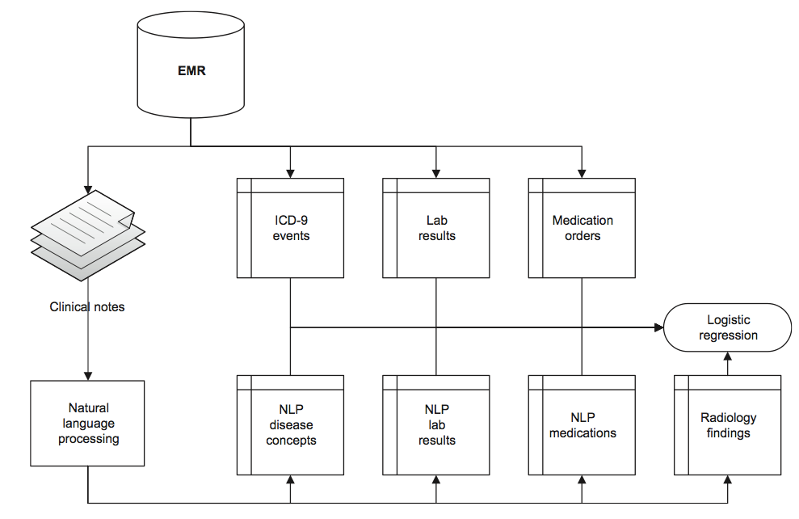
Developing a prediction model
Carroll et al. JAMIA. 2012.

Slide 26
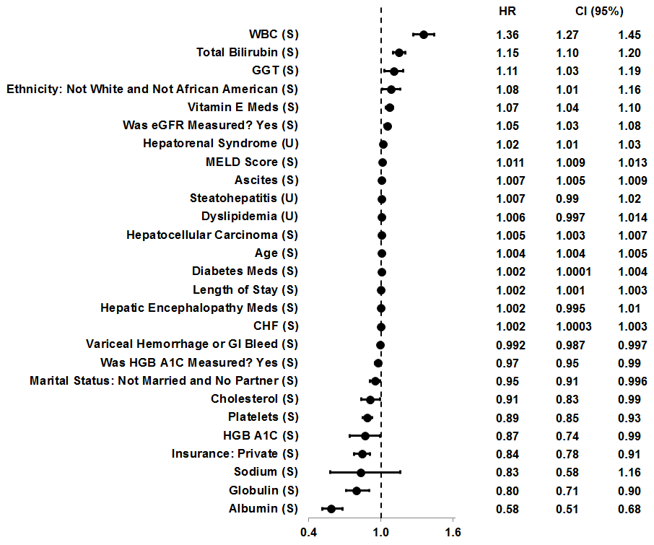
S: Structured
U: Unstructured
Feature selection
Positively
correlated
with
mortality.
Inversely
correlated
with
mortality.
Hazard Ratio

Slide 27
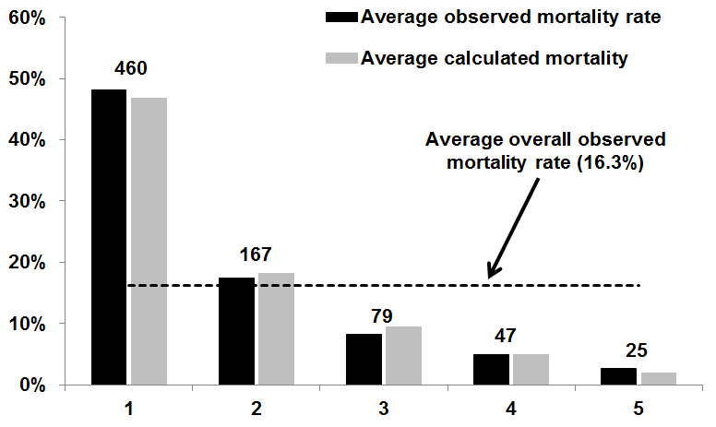
Predicted vs. observed 90-day mortality for 4,781 cirrhosis related admissions
Labels show the observed number of deaths within each quintile.
460
167
79
47
25
Quantile

Slide 28
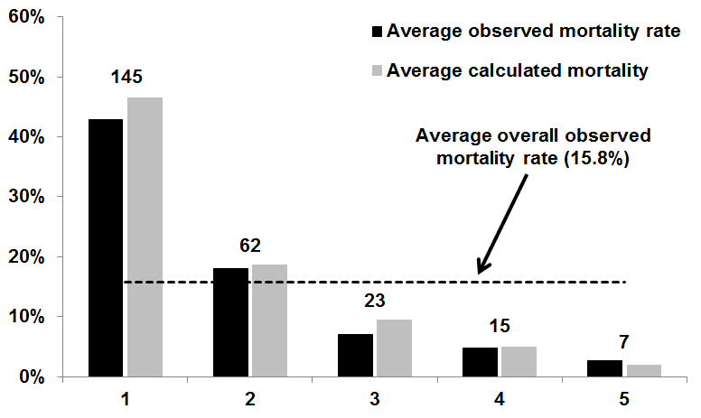
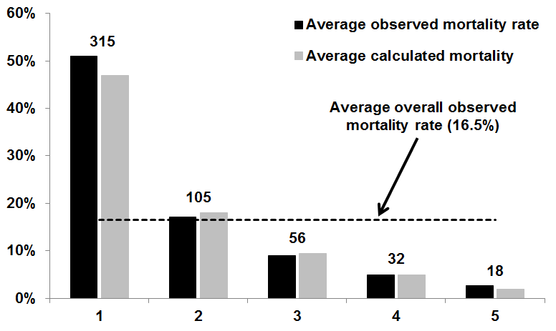
Predicted vs. observed 90-day mortality
315
Derivation set:
3,187 admissions
105
56
32
18
Labels show the observed number of deaths within each quintile.
Quantile
145
Validation set:
1,594 admissions
62
23
15
7
Quantile

Slide 29
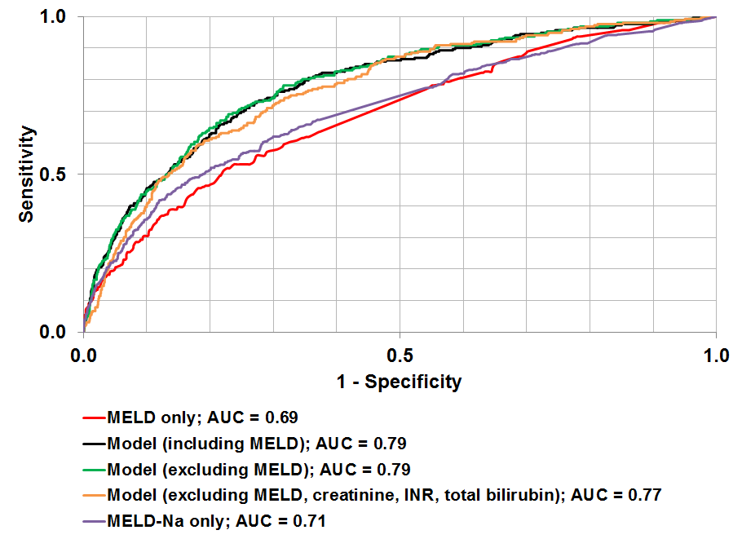
AUCs using varying combinations of variables
Highest performance
Highest performance

Slide 30
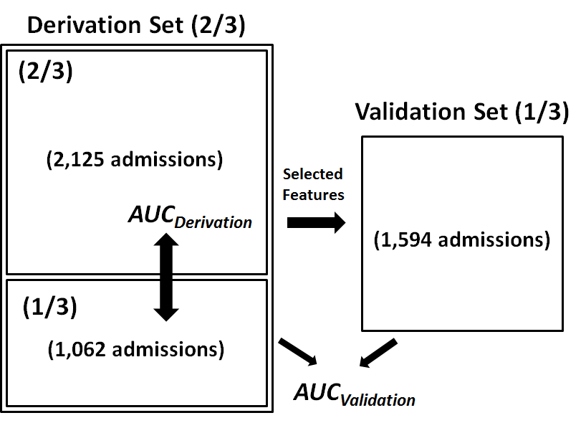
Overfitting evaluation
Logistic
regression
27 variables were selected and yielded AUCs of 0.82 (SE: 0.0016) for the derivation and 0.79 for the validation sets.

Slide 31
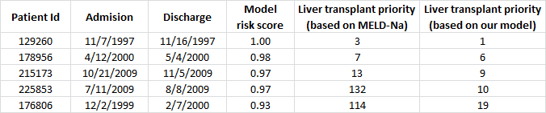
Affecting liver transplantation waiting lists
An inconsistency between MELD-Na
and our risk score: patients might be at a higher risk
and eligible for a more urgent liver transplant.
A high consistency between MELD-Na
and our risk score.
A sample of 5 of the 4,781 admissions.
Notes:
https://www.unos.org/data/transplant-trends/waiting-list-candidates-by-organ-type/

Slide 32
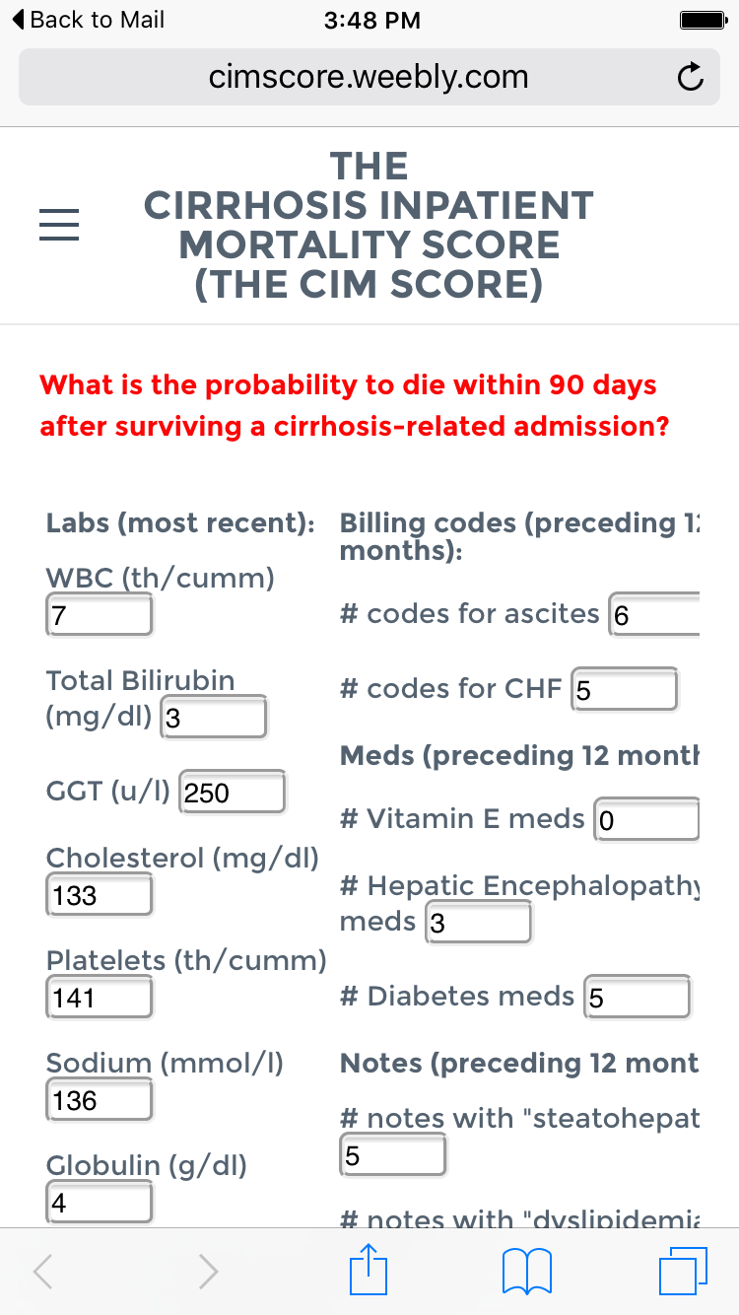
A functional calculator
http://cimscore.weebly.com
Notes:
cimscore.weebly.com

Slide 33
Limitations
Our model is focused only on inpatient cirrhosis admissions.
Our model is a retrospective analysis limited to two hospitals.
Our model requires 12 months of EMR data.

Slide 34
Conclusions
We present one of the largest cirrhosis mortality prediction models
4,871 admissions / 18 years of care.
Our model is unbiased by the number of variables.
We achieved promising results
AUC = 0.79 with 27 variables.
Our model shows strong correlation with observed deaths throughout the range of risk.
We report on new markers to predict mortality in cirrhosis
Combination of structured and unstructured variables.
Complications of cirrhosis may contribute to mortality risk.
We developed an applicable risk score
The score could be deployed in EMR platforms.
The score could affect programs to better accurately list candidates needing liver transplants.

Slide 35
The MELD-Plus score
A collaboration between Massachusetts General Hospital and IBM Research.

Slide 36
A use case:
A potentially new type of
covariate in lung

Slide 37
How to quit smoking and then introduce a new type of covariate in respiratory?
Publish a viewpoint
in the European Respiratory Journal
Start smoking
Get admitted for lung issue
1993
2008
2018
Try a variety of standard approaches
Smoking status: Past

Slide 38
Play video:
“A hole in the Lung”
(3.5 minutes)

Slide 39
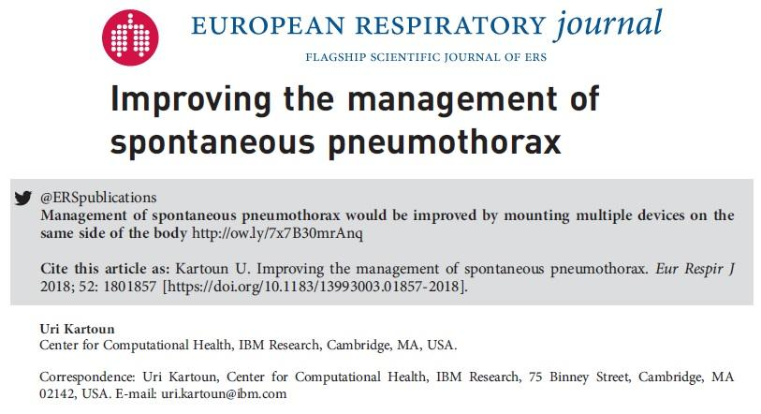

Slide 40
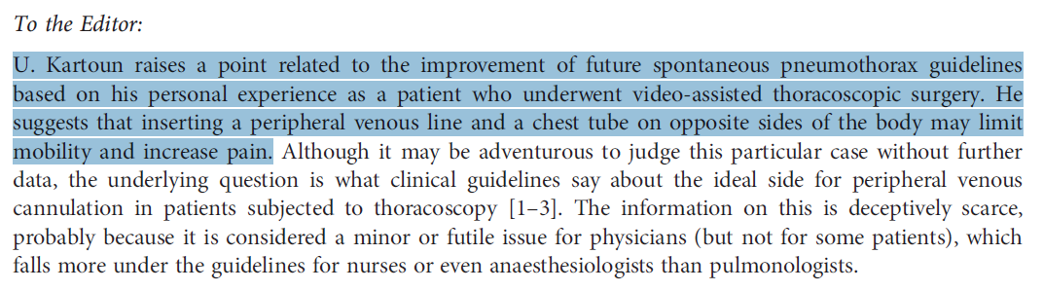
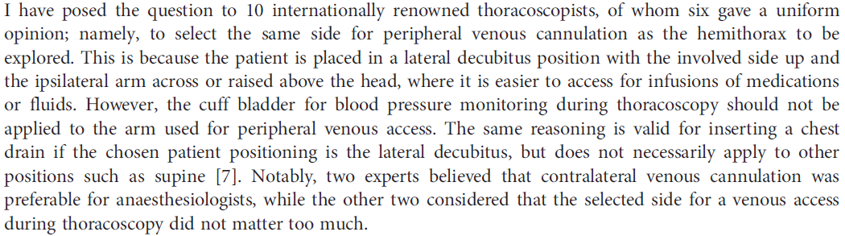

Slide 41
A use case:
Development of an Algorithm to Identify Patients with Physician-Documented Insomnia

Slide 42
In the US insomnia is associated with 252 million days of lost work per year and an annual cost of $63 billion.
(Kessler et al 2011)

Slide 43
Sleep-related complaints are second only to complaints of pain as a reason to seek medical attention.
(Mahowald and Schenck 2005)

Slide 44
The frequency of insomnia diagnosis codes in longitudinal databases underestimates its actual prevalence.
(Wallander et al 2007; Meltzer et al 2010; Brass et al 2014)

Slide 45
Developing an algorithm to classify insomnia patients
Carroll et al. JAMIA. 2012.

Slide 46
Which patients were considered?
Massachusetts General Hospital
AND
Brigham and Women’s Hospital
~4M patients
≥1 ICD9 for diabetes
OR
≥1 diabetic medication
OR
HGB A1C ≥ 6.5%
OR
Plasma Glucose ≥ 200 mg/dl
314,292 patients

Slide 47
Which covariates were considered?
ICD9 codes for insomnia
Socioeconomic
Age, Gender, Ethnicity.
Comorbidities
Diabetes, Anxiety / depression, Renal failure, Hypertension, CHF, etc.
Medications
Trazodone, Ambien, etc.
Structured
Sleep disorder
Alcohol use
Smoking status
Psychiatric disorder
BMI
Text Nailing
Unstructured

Slide 48
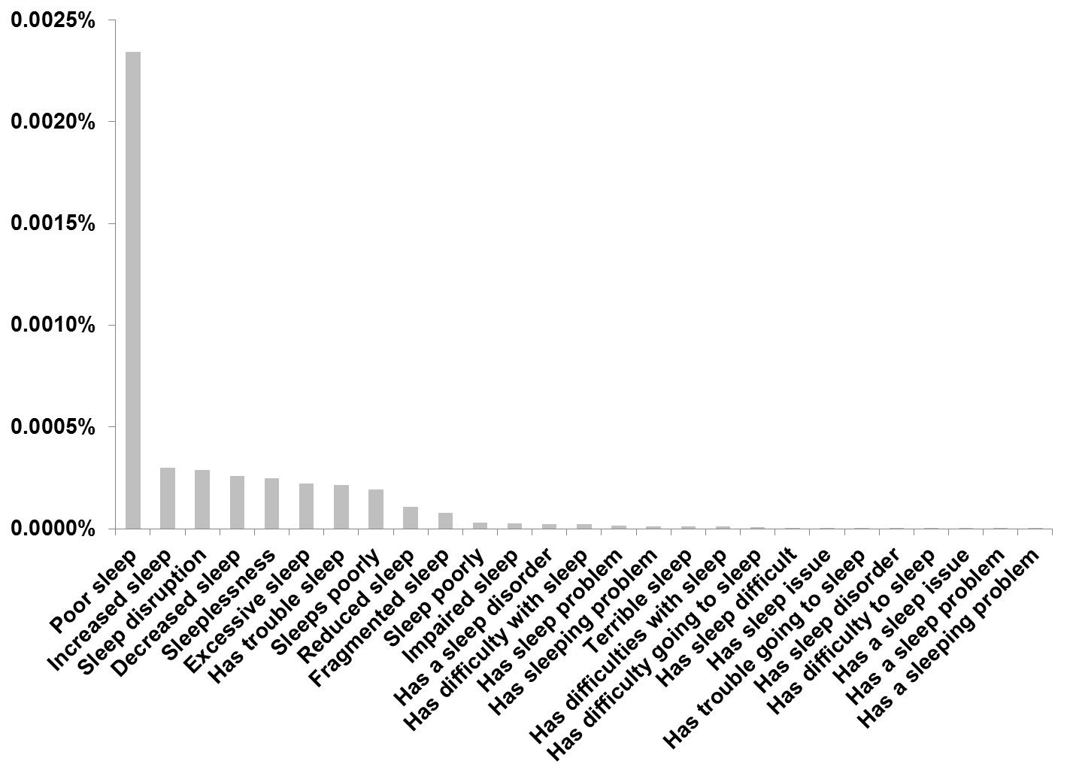
Sleep disorder expressions
Considering 1 million randomly selected notes

Slide 49
“… Symptoms include poor sleep, poor appetite, and a reluctance to leave the house or to exercise …”

Slide 50
“… Clearly, her sleep is very disrupted and we have concerns that her sleep disruption may be contributing to some of her daytime performance issues …”

Slide 51
“… REVIEW OF SYSTEMS: Notable for some weight gain as well as some increased sleepiness, but notes no local neck symptoms, no palpitations, heat intolerance, or tremulousness …”

Slide 52
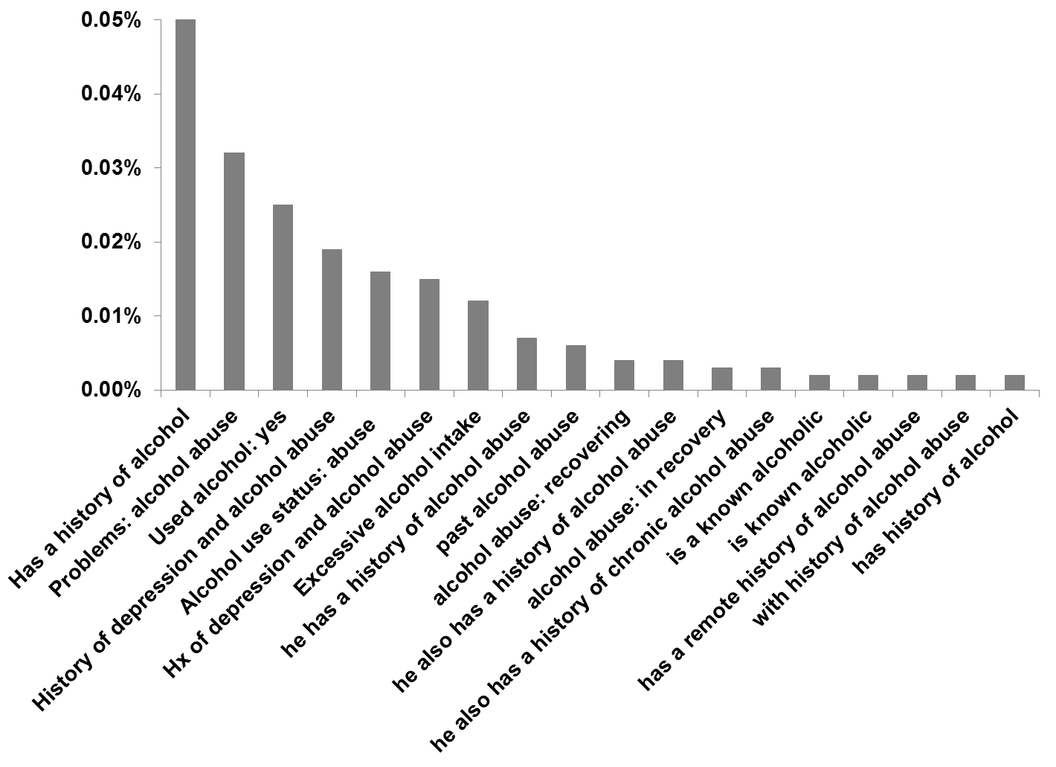
How do clinicians document alcohol use?
Considering 10,000 randomly selected notes

Slide 53
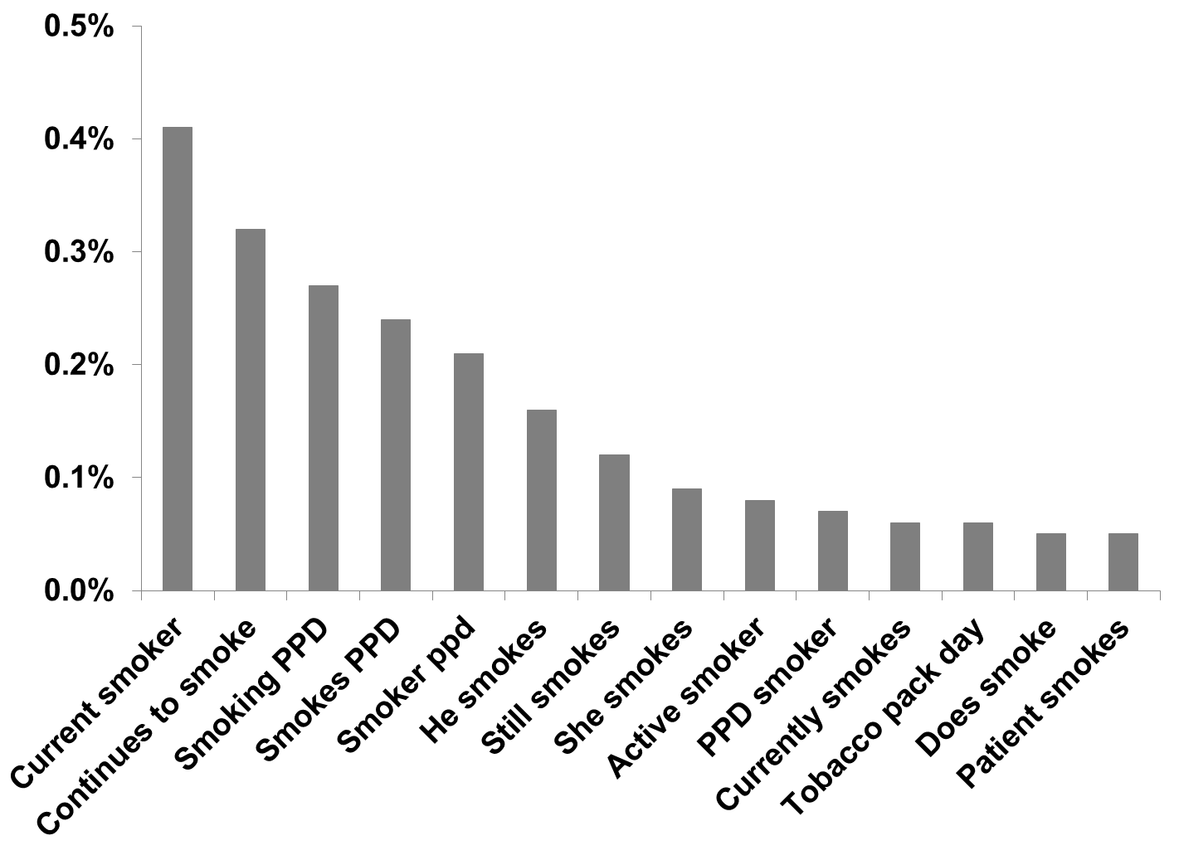
Smoking status: Current
Considering 10,000 randomly selected notes

Slide 54
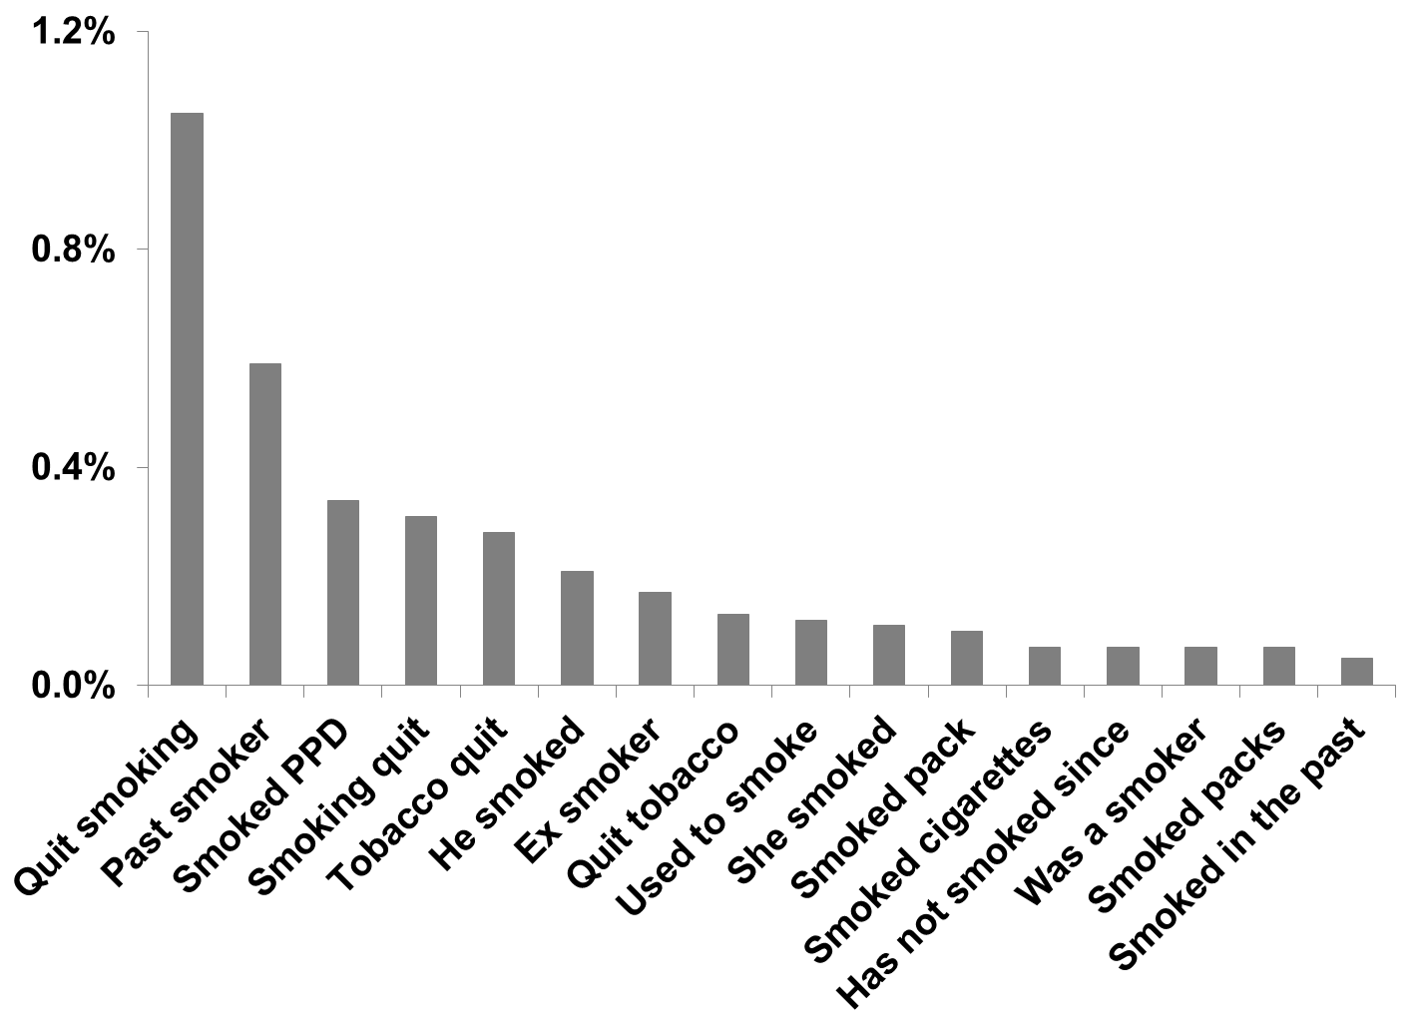
Smoking status: Past
Considering 10,000 randomly selected notes

Slide 55
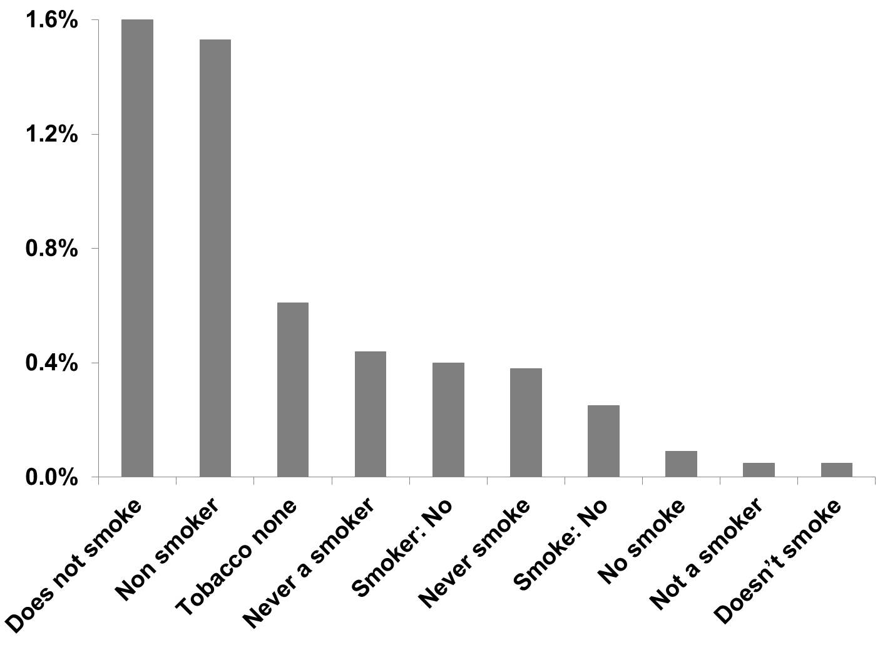
Smoking status: None
Considering 10,000 randomly selected notes

Slide 56
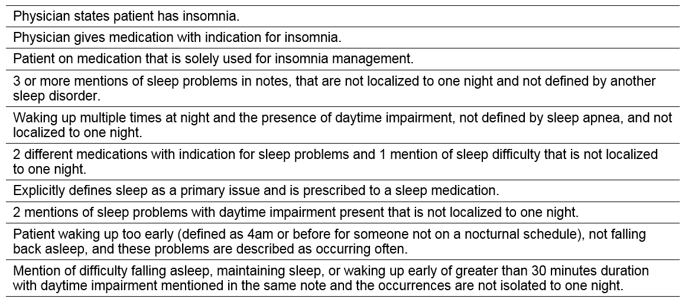
Criteria used to manually label insomnia patients
Combining MGH clinicians’ experience while considering
“The Diagnostic and Statistical Manual of Mental Disorders - V” (DSM-V).

Slide 57
How did we classify insomnia vs. non-insomnia patients?
~314,292 patients at increased risk
for metabolic syndrome
Massachusetts General Hospital
Brigham and Women’s Hospital
≥2 notes each has >500 characters. A note could be either a clinical report or a discharge summary.
≥1 billing codes for insomnia OR
≥1 notes with a mention of sleep keywords OR
≥1 prescriptions for sleep meds
Validation (200 patients)
(97% specificity, 93% PPV)
(Randomly selected)
Potential insomnia candidates: 164,349 patients
Randomly
selected
Training (400 patients)
Validation (200 patients)
Apply feature selection
using structured and unstructured variables
36,810 insomnia patients
(97% specificity, 93% PPV)
Notes:
A total of 600 patients were manually labeled:
230 patients had insomnia.
270 patients did not have insomnia.
100 patients did not have a clear insomnia status.
We used then the 230 + 270 = 500 patients to develop the algorithm.
7 of these 500 patients were excluded because their age was below 18 (date of death or date of the end of the cohort). 2/3 of these (328) served as a training set while the rest (165) served as a validation set.

Slide 58
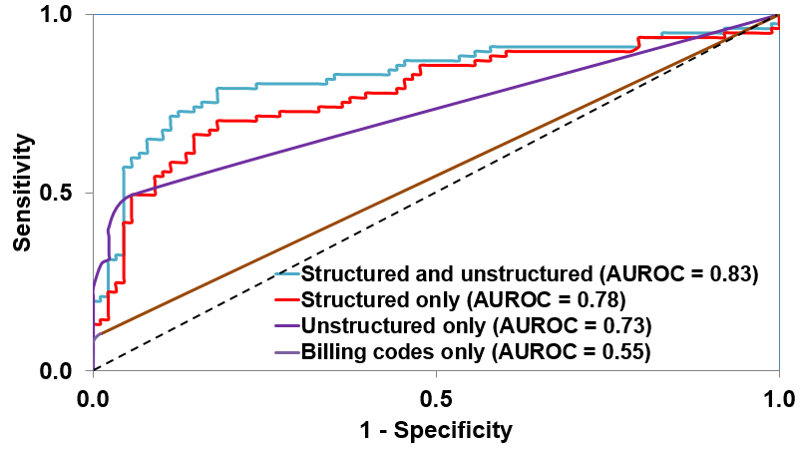
Results
Notes:
Using varying combinations of structured and unstructured data

Slide 59
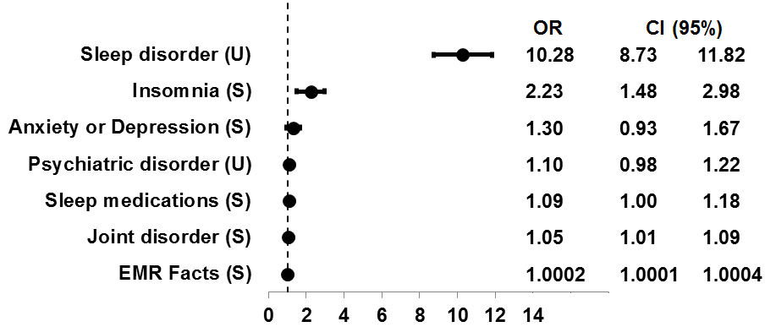
Variables selected for insomnia classification
Combining structured and unstructured data
Odds ratio
S = Structured
U = Unstructured
OR = Odds ratio
CI = Confidence interval

Slide 60
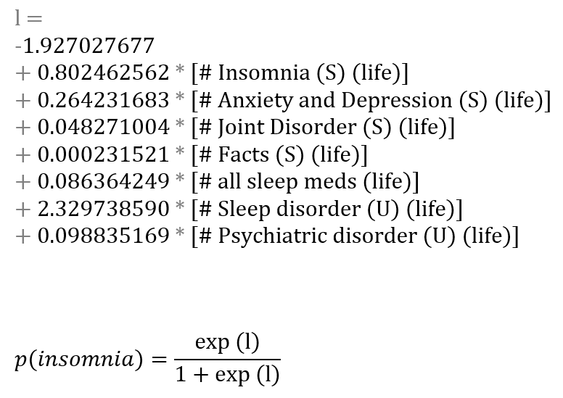
Generalized linear model
36,810 insomnia patients

Slide 61
Cohort characteristics
36,810 insomnia patients
Average age: 62 years
59.4% females
72.9% White, 10.4% African American
~16K patients are followed for at least 5 years
Demographics
79.3% joint disorder
75.4% hypertension
55.9% diabetes (either type I or II)
46.9% anxiety / depression
1.9% Alzheimer’s / dementia
Comorbidities

Slide 62
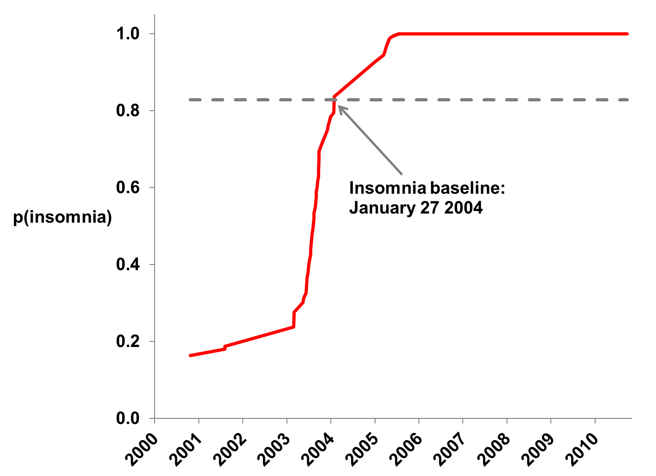
Deployment of the generalized linear model
An example for one of the 36,810 insomnia patients:
Notes:
Prior to exceeding the insomnia threshold (January 27 2004) the patient’s EMR (notes) indicate that the she suffers from depression and also has sleep issues, thereby went through a sleep study. In notes after this date many other mental issues are documented, such as borderline personality and posttraumatic stress disorder (PTSD).

Slide 63
Text Nailing
A semi-manual method to identify smoking status
10,927,595 notes
314,292 patients
1,014,979 notes
Notes that contain smok, tob, cig
Randomly select a sub-set
For each note observe at the first occurrence of the string smok, tob, or cig, and extract ±50 characters around it.
Copy the 100-character blobs (1,000 blobs) to a text editor for manual review.
1,000 notes
Store expressions of interest and assign them to classes:
Current Smoker
Past Smoker
Never Smoked

Slide 64
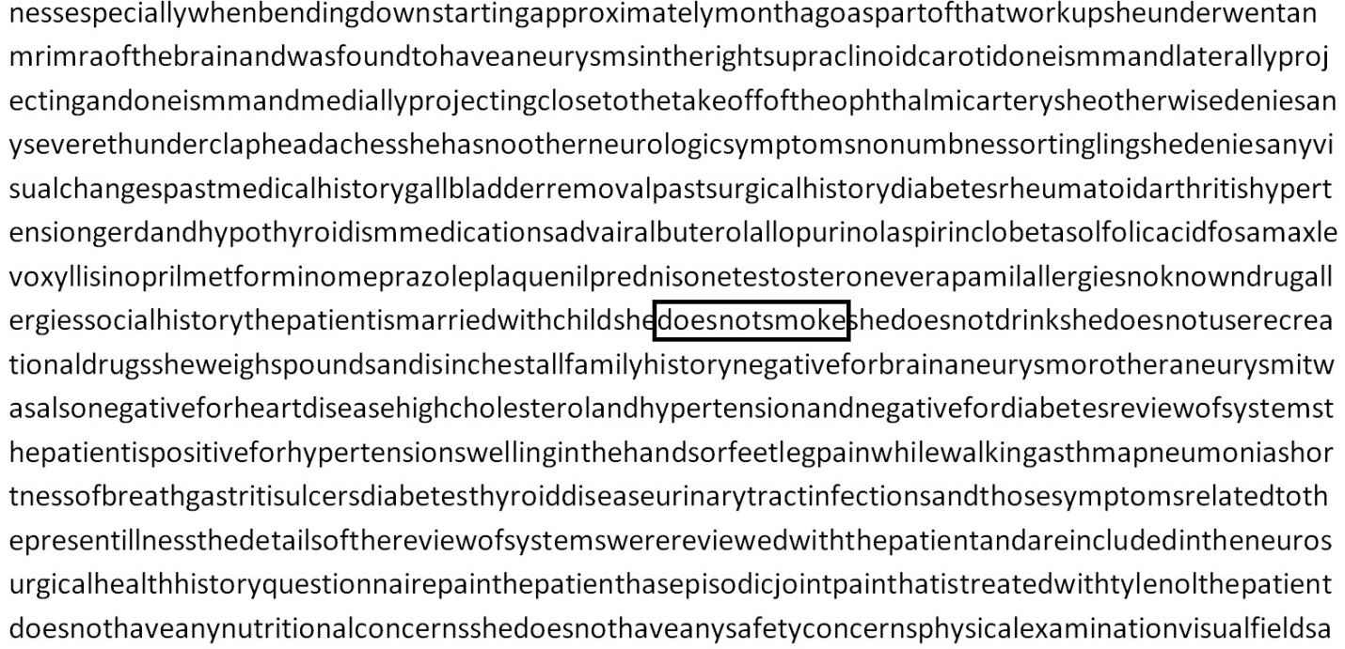
To allow searching for homogeneous expressions, all notes and expressions were converted to an alphabetical-only representation
“… smoked 2 packs per week…”
“… smoked 5 packs per week…”
“… smoked: 4-6 packs per week…”
smokedpacksperweek
(Past Smoker)

Slide 65
Conclusions
We present one of the largest insomnia cohorts
36,810 patients / 20 years of care
We achieved good results
AUC = 0.83 with 7 variables
We developed an applicable risk score
The score could be deployed in EMR platforms
We developed a new text processing method
Outperforms traditional methods

Slide 66
A use case:
A Risk Model for 30-Day Heart Failure Re-Admission using Electronic Medical Records

Slide 67
What is known?
Congestive heart failure.
1.1 million US CHF admissions amounted to nearly $29 billion.¹
T2D is a common disease affecting 25.8 million people in the US.²
Patients with T2D are at 2.4 to 5-fold increased risk of developing heart failure.³
Re-admissions after a CHF admission is one of the leading problems facing the US healthcare system.
Among Medicare beneficiaries the rate of 30-day CHF re-admission approaches 25%.⁴
After pneumonia, CHF is the second most common cause of hospital admission.⁵
About 12.5% of Medicare CHF admissions are followed by a potentially preventable re-admission within 15 days.⁶
1. Russo and Andrews, 2006.
2. Centers for Disease Control and Prevention, 2011.
3. Kannel et al., 1974.
4. Jencks et al., 2008.
5. Elixhauser and Owens, 2006.
6. Medicare Payment Advisory Commission, 2007.

Slide 68
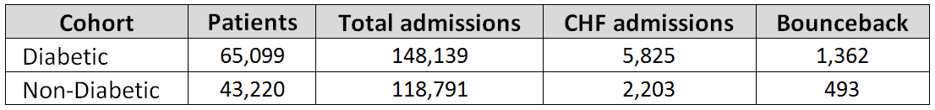
Prediction models
An inpatient CHF admission
Patient
admitted
Patient
discharged
Re-admission?
Yes/No
24H
For a patient who was not
re-admitted: has ≥ 1 EMR facts
“Early”
228 Variables (12 months)
30 days
“Discharge”
293 Variables (12 months)

Slide 69
Variables
Total of 293 variables
Socioeconomic
Age, Gender, Language, Race, Marital status, Insurance type
Population percentage below poverty
Historical measurements
Number of admissions past year
Number of outpatient visits past 30 days
Average length of stay admissions past year
15 types of medical comorbidities
60 types of labs
Value
Measured / not measured
Slope during admission

Slide 70
Variables (more)
Total of 293 variables
Cardiac measurements
From ultrasound reports:
Left ventricular ejection fraction
Right ventricular systolic pressure
Chamber and wall dimensions
From EKG reports:
Conduction intervals
Extracted from discharge reports
Discharge location, Accompanied home by
Is follow-up appointment scheduled?
Additional measurements
Length of stay
Number of labs measured
Season

Slide 71
CHF concepts using NLP
Total of 293 variables
60 types of concepts considering ~20M notes (physician narrative, discharge,
cardiology, radiology, pathology)
Medications
Diagnostic tests
Therapeutic procedures
Comorbidities
Confounding diagnoses
CHF signs and symptoms
Cardiovascular complications

Slide 72
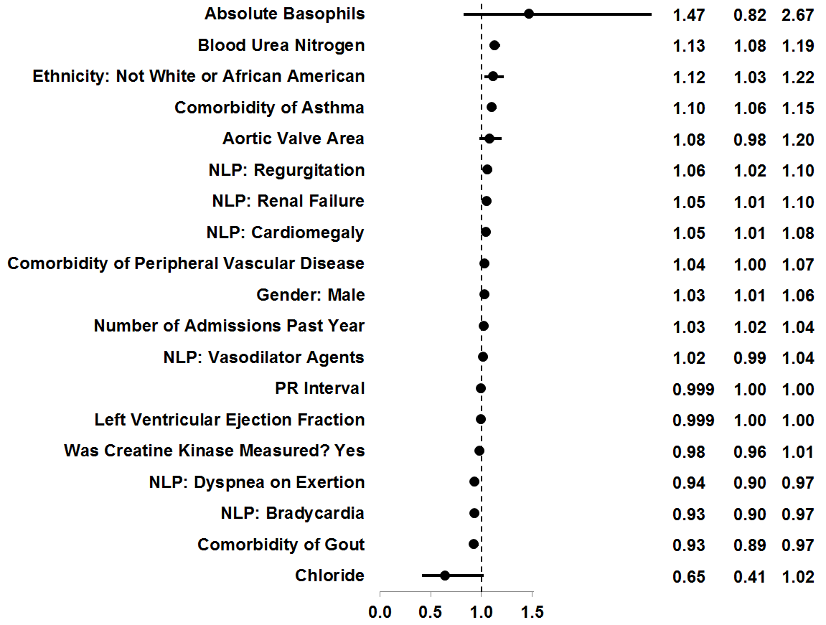
Feature selection
“Early” model / diabetic cohort:
HR CI (95%)
Hazard Ratio
Notes:
Adaptive LASSO penalizes non-important variables and keeps only those that are useful to achieve the highest AUC.
Confidence intervals were calculated using Bootstrapping.
NLP = “Natural Language Processing”.

Slide 73
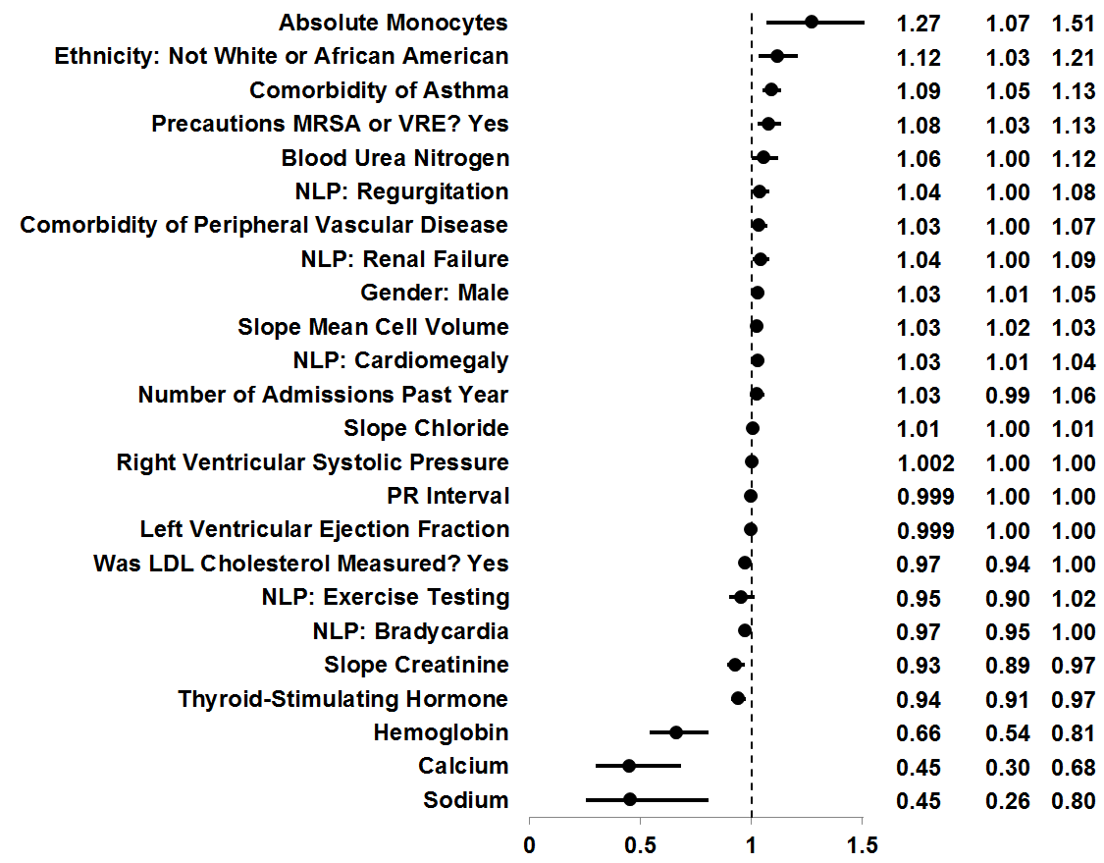
Feature selection
“Discharge” model / diabetic cohort:
HR CI (95%)
Hazard Ratio
Notes:
Adaptive LASSO penalizes non-important variables and keeps only those that are useful to achieve the highest AUC.
Confidence intervals were calculated using Bootstrapping.
NLP = “Natural Language Processing”.

Slide 74
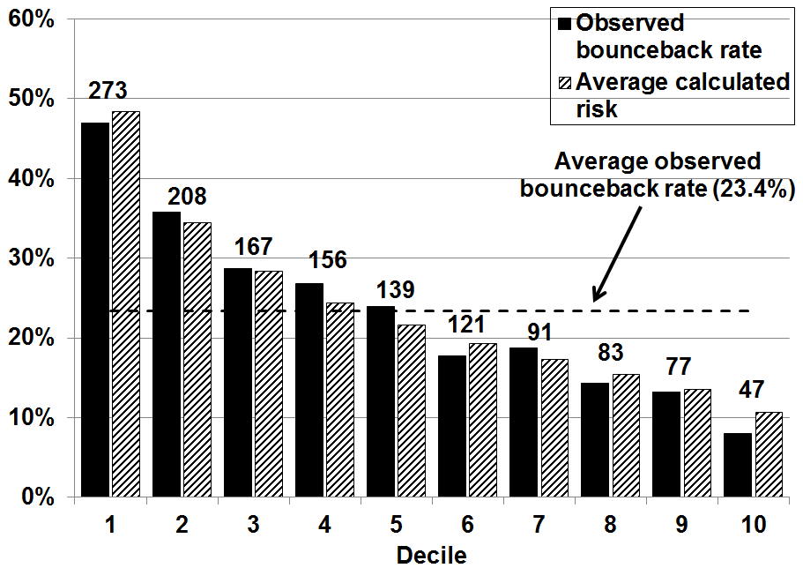
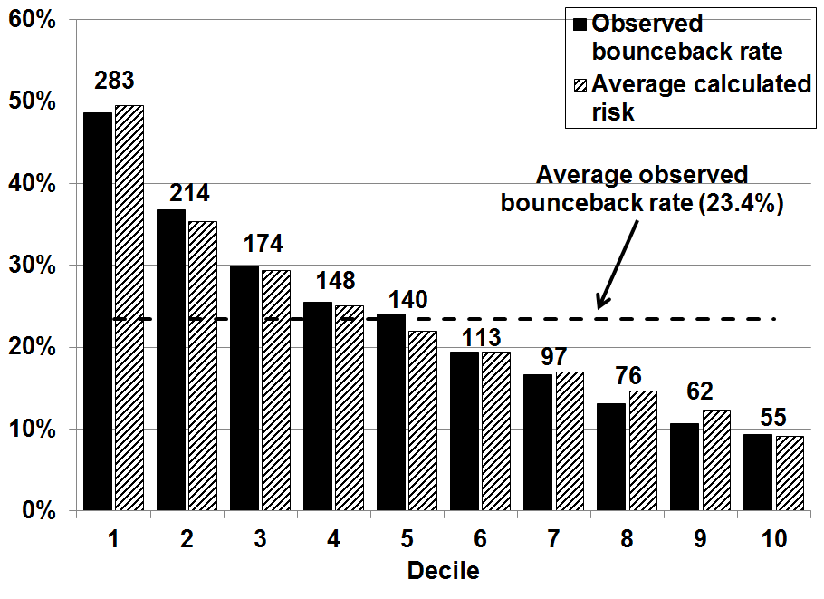
Risk assessment
Diabetic Cohort (5,825 admissions):
Patient
admitted
Patient
discharged
Re-admission?
Yes/No
“Early”
24H
228 Variables
(12 months)
30 days
Highest risk
Lowest risk
Patient
admitted
Patient
discharged
Re-admission?
Yes/No
“Discharge”
293 Variables
(12 months)
30 days
Highest risk
Lowest risk

Slide 75
Re-classification
Diabetic Cohort (5,825 admissions):
“Early”
195 patients
291 patients
Highest risk
Lowest risk
“Discharge”
Highest risk
Lowest risk

Slide 76
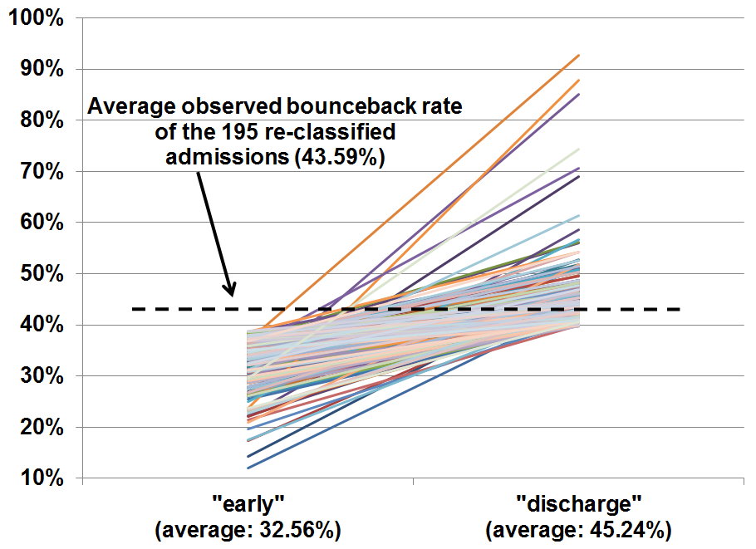
Risk shifting to the highest risk 1st decile during an admission
Calculated
risk
Diabetic cohort

Slide 77
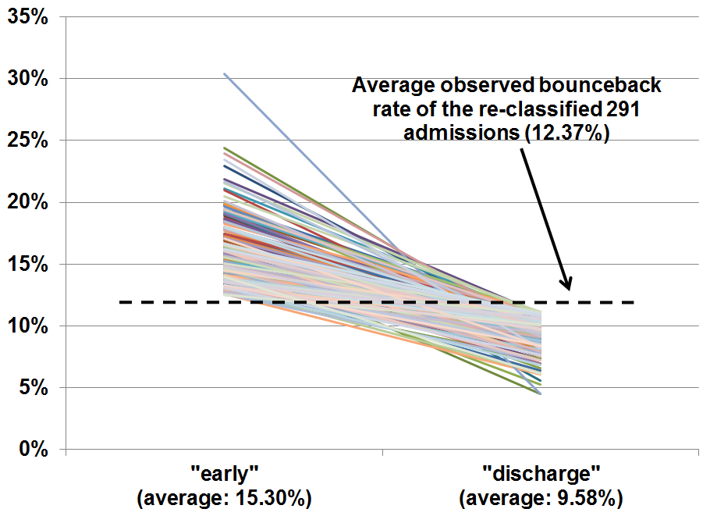
Risk shifting to the lowest risk 10th decile during an admission
Calculated
risk
Diabetic cohort

Slide 78
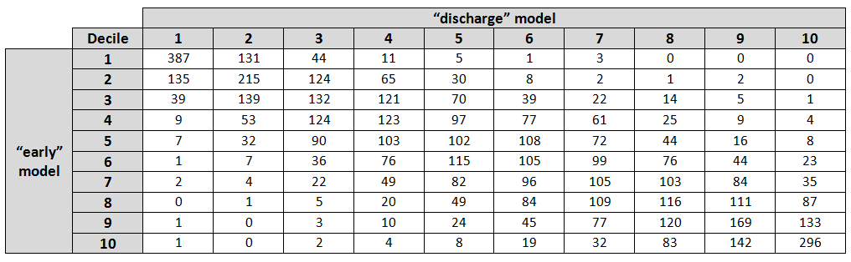
Risk shifting between the “early” and “discharge” models across deciles
Highest risk
Lowest risk
Highest risk
387
Lowest risk
296
In terms of prediction accuracy, the “discharge” model is more accurate
(AUC = 0.67 vs. 0.65).
Most high risk patients at the “early” model stay high risk at “discharge“ model.
Most low risk patients at the “early” model stay low risk at “discharge” model.
Diabetic cohort

Slide 79

Prediction accuracy
Logistic
regression
 | “Early” model (228 variables) | “Discharge” model (293 variables)
Variables selected | 19 | 24
AUC Derivation (100 runs) | 0.65 (SE: 0.0015) | 0.66 (SE: 0.0017)
AUC Validation | 0.65 | 0.67

Slide 80
Conclusions
We present one of the largest CHF re-admission prediction models:
>100,000 patients comparing two populations.
Over 17 years of care.
Our models are unbiased by the number of variables.
We developed new variables that could be used by engineers, researchers, and hospitals:
Lab slopes.
Narrative CHF concepts.
Comorbidities as continuous variables.
Variables extracted from ECHO, EKG, and discharge notes.
We achieved promising results:
AUC = 0.67 with ~20 variables.
Our models show strong correlation with observed bouncebacks throughout the range of risk.
Opportunity for
an early intervention
We developed a new patient re-classification framework:
Patients classified as high risk by early model stay high risk.
The final classification model is more accurate.

Slide 81
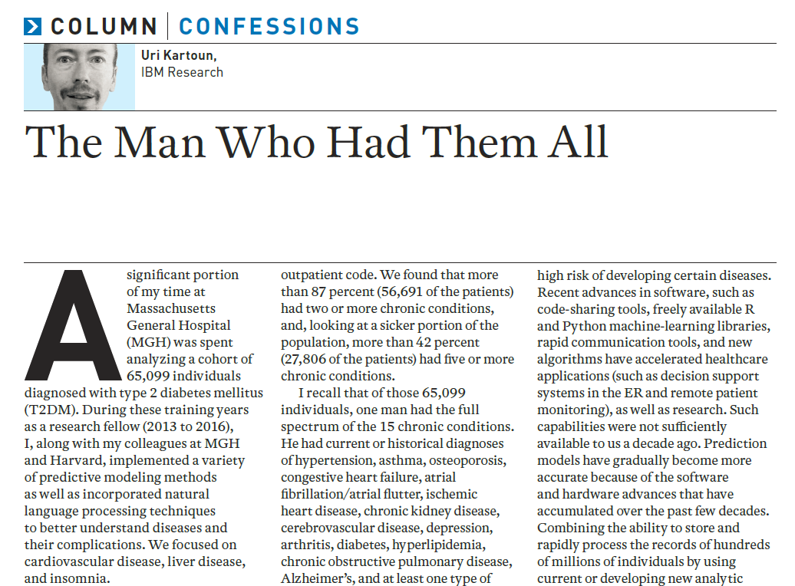

Let’s take a look in person…

Slide 82
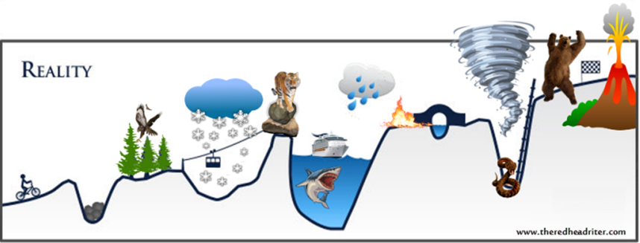
I am currently here.
Help me get here.

